Slide 1

University Of Buea
Faculty of Engineering And Technology.
CEF440
Internet Programming and Mobile Programming
TASK 1

Slide 2
Instructor: Dr Nkemeni Valery
Presented By..
Name Of Student | Matriculation Number
IHIMBRU ZADOLF ONGUM | FE21A203
FONJI DANIEL KUKUH | FE21A194
NFOUA EUGENE MGBA | FE21A257
EPIE MUKEH SANDRA | FE21A185
CHE KASSINA KUM | FE21A158

Slide 3
Review and compare the major types of mobile apps and their differences
Here, we are going to Review Mobile App Types, Programming Languages, Frameworks, Architectures, Requirements Engineering, and Cost Estimation

Slide 4
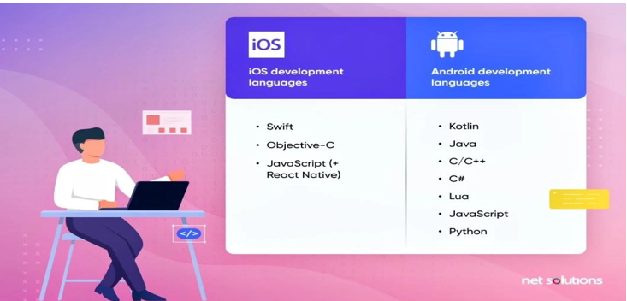
Major Types Of Mobile Apps
Native Apps:
A native app only runs on a specific mobile operating system. It won’t run on other mobile operating systems. So, for example, if you develop a native app for iOS, you’d do the development in the Xcode environment using Swift. For Android, developers commonly use Android Studio and Java.
Native apps can normally access all the functionality of the chosen device easily. You can run them without error on the device if developed properly.

Slide 5
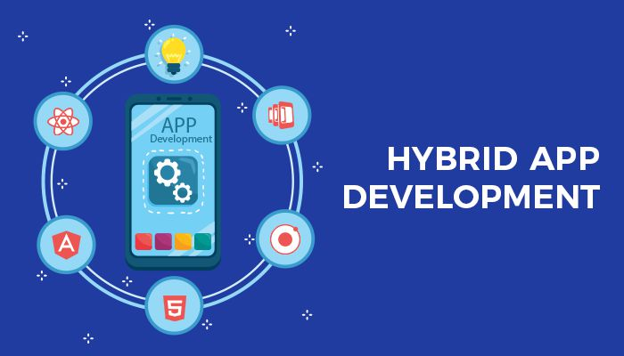
Hybrid Apps
A hybrid app works on multiple platforms. You write it with a single standard code language (such as C# or a combination of HTML5 and JavaScript) and then compile and execute it on each platform. The use of plugins for that operating system will manage device-specific interactions.
Hybrid app development environment include:
1. Ionic: A popular open-source framework for building hybrid mobile apps using web technologies such as HTML, CSS, and JavaScript.
2. React Native: A framework for building mobile apps using React, a popular JavaScript library for building user interfaces.
3. Xamarin: A framework for building mobile apps using C# and .NET, which allows developers to share code across multiple platforms.

Slide 6

Web Apps
A web app or browser-based app can deliver similar functionality to an app as a website. In fact, with a little creativity, you can keep the differences to a minimum and design a web app so it looks and feels pretty much like a native app.
1. Progressive Web Apps (PWAs): These web applications deliver an app-like experience using modern web capabilities. They work on any standards-compliant browser platform.
2. Responsive Web Apps (RWAs): RWAs adapt to different screen sizes. They use responsive design to adjust the layout and content automatically. This ensures a consistent and smooth experience across all devices, from smartphones to desktops.

Slide 7
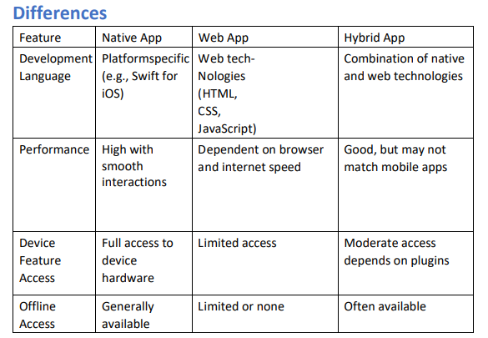
Differences between Native, Web and Hybrid Apps

Slide 8
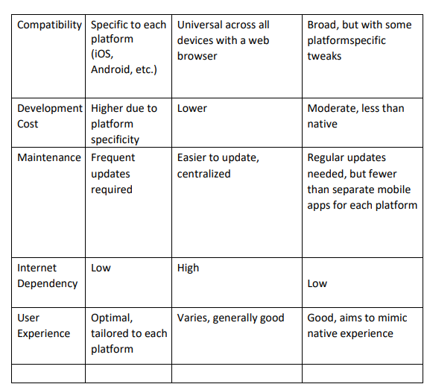

Slide 9
Popular Programming Languages for Mobile Apps 1/2
Swift: In 2022, Swift continues to reign as the primary language for iOS app development, surpassing Objective-C since its inception in 2014. Renowned for its user-friendliness and focus on expressiveness, safety, and speed, Swift remains a popular choice among developers, especially newcomers.
Kotlin: The official Android programming language is Kotlin, although it is one of many languages that we can use for Android app development. Kotlin is a simple language with a powerful, clean syntax and combines both acquisitive and functional programming features to allow for faster compilation
Javascript : JavaScript is a top language choice by many developers for mobile apps in coordination with frameworks such as React Native, Cordova, NativeScript, and Appcelerator.
Objective-C: Once the official language for iPhones, Objective-C remains a common iOS programming language due to its stable performance, resource availability, and compatibility with C++.

Slide 10
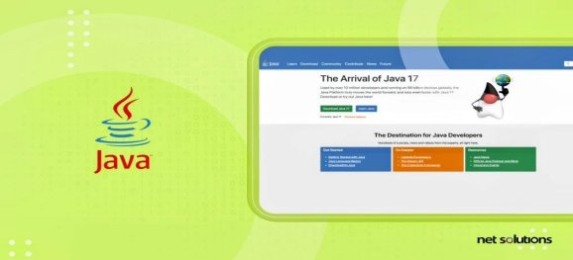

2/2
Java : Once the official language for iPhones, Objective-C remains a common iOS programming language due to its stable performance, resource availability, and compatibility with C++.
Python : Python has been around since the 80s and is still considered the top programming language, making it an ideal beginner choice due to its versatility in creating mobile apps and a wide variety of other software. It is English-syntax based with many robust libraries

Slide 11
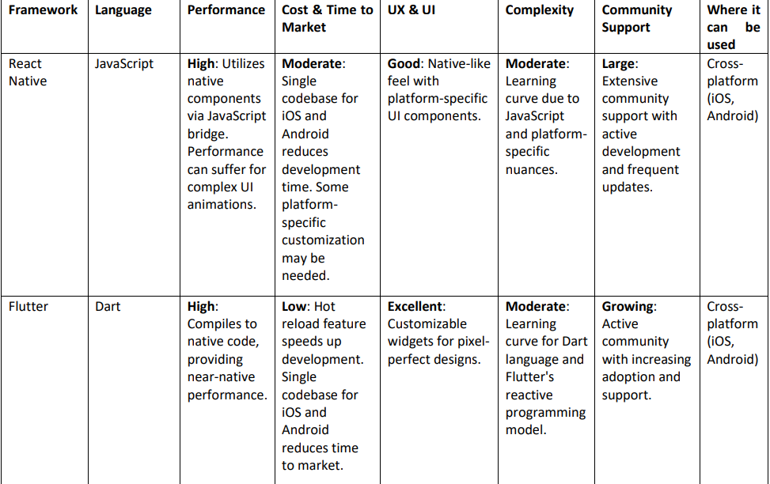
3) Review And Comparison Of Mobile App Development Frameworks By Comparison Of Their Key Features And Where They Can Be Used.

Slide 12
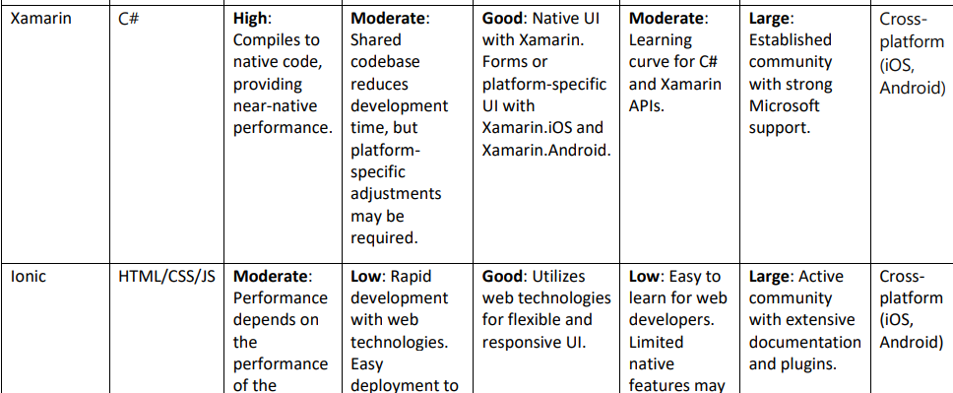
2/3

Slide 13
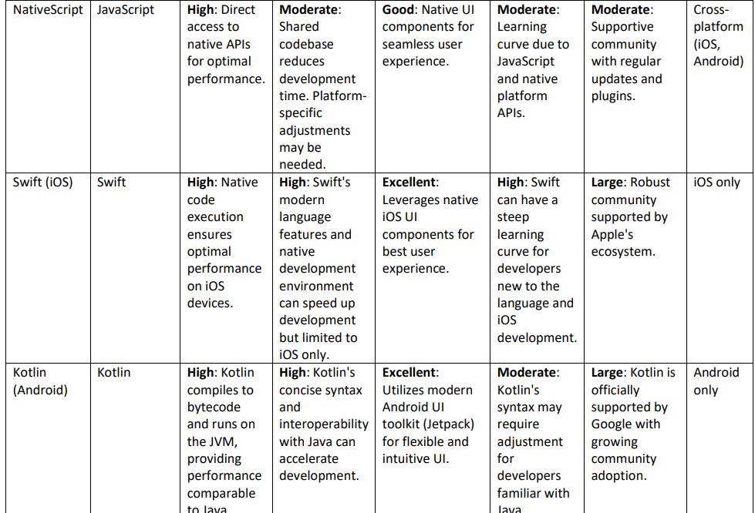
3/3

Slide 14
4) Mobile Application Architectures And Design patterns
An application architecture describes the patterns and techniques used to design and build an application. The architecture gives you a roadmap and best practices to follow when building an application, so that you end up with a well-structured app. Software design patterns can help you to build an application.
The Key components of a Mobile Architecture includes:
User Interface (UI) Layer, which is responsible for the presentation of the app to the user.
Application Logic Layer , which houses the core functionality of the app. It includes algorithms, business rules, and processes that control the app’s behavior
Data Layer , which manages data storage, retrieval, and communication with external data sources. It includes databases, server APIs, and any data repositories that the app interacts with.
Next, we are going to look at the various types of Mobile application architectures

Slide 15
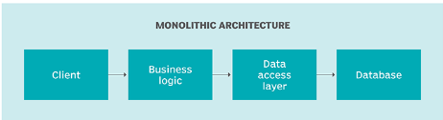
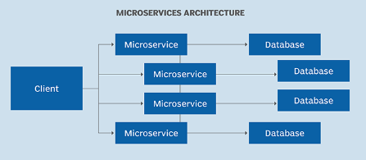
Types of Mobile app Architectures
Monolithic Architecture : In monolithic architecture, all components and modules of an application are tightly integrated into a single, unified unit. In a monolithic architecture, the entire application, including the user interface, application logic, and data storage, is bundled together as a single codebase and runs within a single process
Microservices Architecture: In a microservices architecture, an application uses small, independent, and loosely coupled services that operate simultaneously to provide its functionality.
1/3

Slide 16
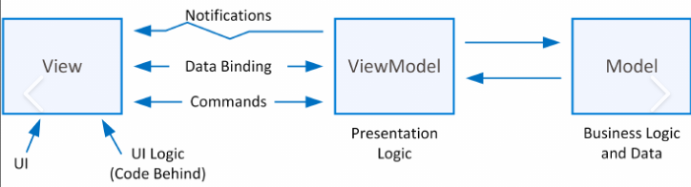
3) Model-View-ViewModel (MVVM): Model-View-ViewModel (MVVM) is an architectural design pattern used primarily in software development for building user interfaces. MVVM is especially popular in modern mobile and web applications
Model: This represents the application’s data and business logic. It is responsible for data storage, retrieval, validation, and processing.
View, which represents the user interface and is responsible for displaying data to the user. In MVVM, the View is the visual component of the application
ViewModel, which serves as an intermediary between the Model and the View
2/3

Slide 17
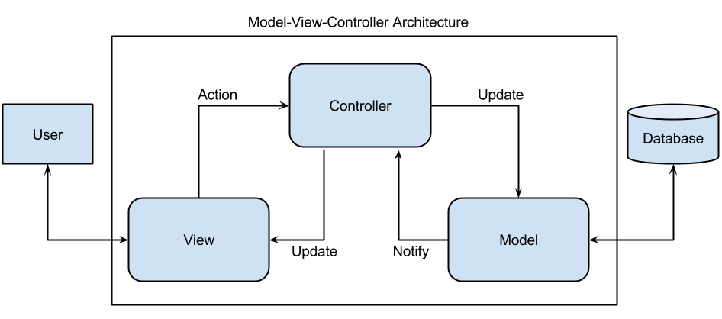
4) Model-View-Controller (MVC)
Model-View-Controller (MVC) is a widely used architectural design pattern for developing software applications, particularly in web and mobile applications.
It divides the application into three interconnected components, each with a specific role and responsibility. The primary purpose of the MVC pattern is to separate the concerns of an application, making it easier to develop, maintain, and extend.
3/3

Slide 18
5) How to collect and analyse user requirements for a mobile application
Collecting and analyzing user requirements is crucial for building a successful mobile application. Here are some steps to follow:
Define App Idea and Purpose
Conduct Market and Competitor Analysis
Identify Your Target Users
User Research Techniques
Analyze and Prioritize Requirements

Slide 19
6) Estimating Mobile App Development cost
Determining the cost of mobile app development isn’t a one-size-fits-all process. It involves several factors such as features, complexity, platforms d that vary from one project to another. Here are some factors:
Features and functionalities of the App:
Platforms (iOS, Android, Both):
Design (UI and UX):
. Third-party integration and Backend Development:
Location and Development Team:
Maintenance and Updates:
Development Time:
Now, let’s look at some methods that are used to estimate Mobile App development Cost

Slide 20
Method for Estimating Mobile App Development Costs
Fixed Price Model
Time and Material Model
Dedicated Team Model
After examining the methods of estimating mobile app development cost, next we have to research on ways to reduce the actual cost of the Application…. Some of which include…
Set clear goals for your app
Develop a cross-platform app
Adopting a Minimum Viable Product (MVP) Approach

Slide 21
THANKS FOR YOUR KIND ATTENTION

